Slide 1
React JS

Slide 2
Why React JS?
React is Flexible
React Has a Great Developer Experience
React Has Facebook's Support/Resources
React Has Broader Community Support
React Has Great Performance
React is Easy to Test
Mature, simple-to-grasp development workflow.

Slide 3
What is React JS?
It is an open-source JavaScript library.
It is used for building user interfaces specifically for single-page applications.
It’s used for handling the view layer for web and mobile apps.
It is not a framework.
It does not support MVC architecture.

Slide 4
Features of React JS
One way data binding.
JSX(Javascript XML)
Component Based UI
Virtual DOM
Performance
Conditional Statements

Slide 5
Angular Vs React
Basis of Distinction | Angular | React
Purpose | Full-featured Framework – provides a strong opinion on how your application should be designed, as well as a number of tiny libraries that aid in the development of complex applications. | The library is only concerned with UI components. MVC design requires Flux to implement, but it provides you more flexibility in how you wish to organize your code.
Data binding | Supports both one way and two way data binding ,two-way data binding means that if we modify the UI input, the model state will change, and vice versa. | One-way data binding means that a UI element can’t affect a component’s state.

Slide 6
Angular Vs React
UI Component | Material Design Components – Angular includes a number of material design components that make UI configuration a breeze. | Material-UI Library & Dependencies – Community-developed UI tools provide a wide range of UI components.
Dependency Injection | Dependency injection is supported, allowing for separate life cycles for different stores. | React does not fully enable dependency injection because each component has its own global state.
DOM | Incremental DOM – when a new DOM is created, it compares it to the previous one and applies the differences to the “actual” DOM, only allocating memory if necessary. | Virtual DOM – anytime the DOM changes, a new virtual DOM is created, compared to the previous one, and only the differences are modified in the “real” DOM.

Slide 7
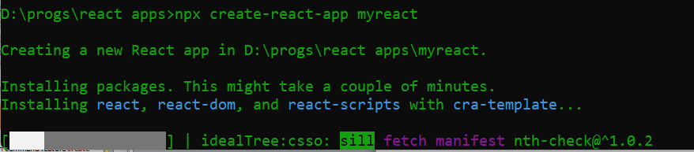
Creating Environment
To create a project in react we have to use npx command tool with command feature create-react-app
npx create-react-app myreact

Slide 8
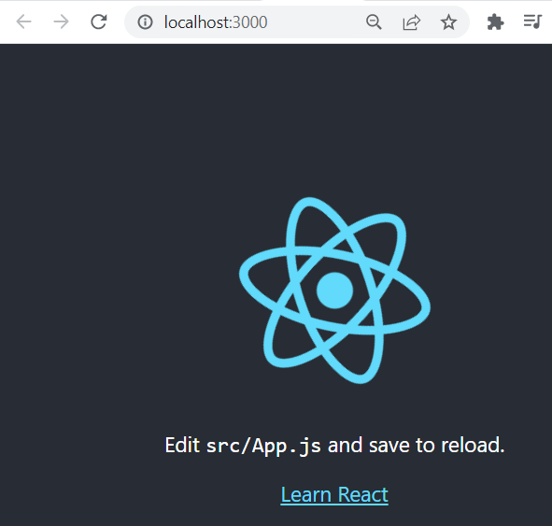
Execution and Output
To execute we need to be in project directory and we have to type
npm start

Slide 9
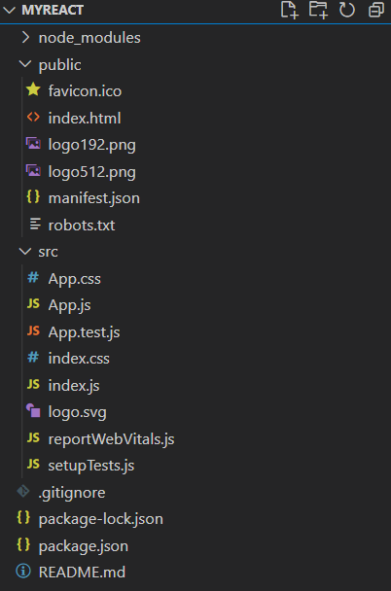
React Project Environment
One important point to be noted here that we don’t need any typescript. All files in react is javascript only.
No separate template file is needed, Components and template are all combined into single file

Slide 10
React Project Environment
File/Folder Name | Description
Public | The public folder holds files which is accessible throughout the project and components
App.js | This is the file for App Component. App Component is the main component in React which acts as a container for all other components.
App.test.js | This file is used for unit testing
Index.js | index.js is where you would usually mount/render your main react component onto your “root” element(which you mark in your html).
reportWebVitals | it measures a set of metrics that aim to capture the user experience of a web page.
setupTests.js | It is used to test app
Package-lock.json, package.json | These are used keep track of packages installed

Slide 11
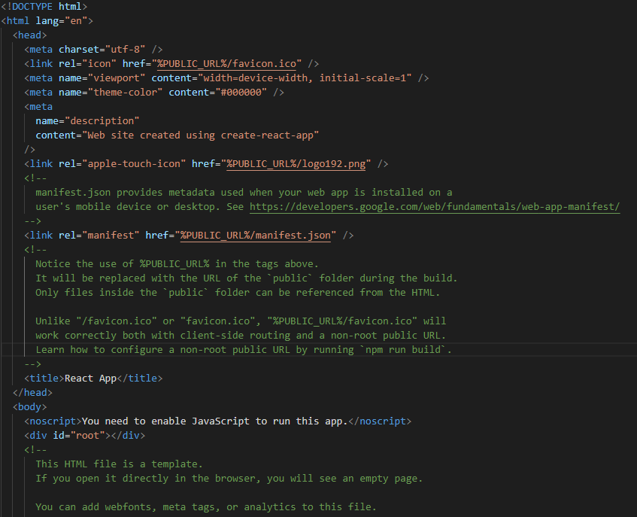
React Project Environment
Index.html file

Slide 12
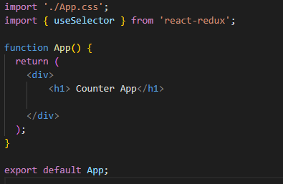
React Project Environment
App.js file

Slide 13
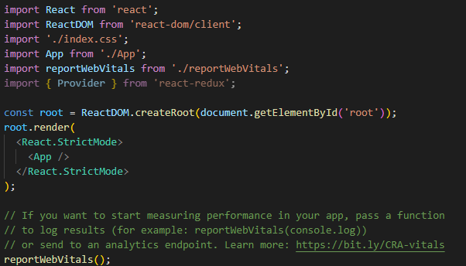
React Project Environment
Index.js

Slide 14
Virtual DOM
What is DOM?
- DOM stands for ‘Document Object
Model’.
- DOM represents the entire UI of your
application.
- The DOM is represented as a tree data
structure. It contains a node for each UI
element present in the web document.
- It is very useful as it allows web developers
to modify content through JavaScript

Slide 15
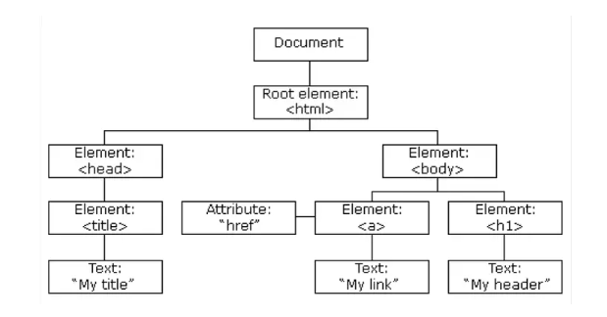
Virtual DOM

Slide 16
Virtual DOM
Updation of DOM
- Every time there is a change in the state
of your application, the DOM gets
updated to reflect that change in the UI.
- This is problem with large number of
elements in UI.
- Problems are: how frequently is it
updated? Any CSS property changes? Any
new element is added or removed?

Slide 17
Virtual DOM
// Simple getElementById() method
document.getElementById('some-id').innerValue = 'updated value';
The browser parses the HTML to find the node with this id.
It removes the child element of this specific element.
Updates the element(DOM) with the ‘updated value’.
Recalculates the CSS for the parent and child nodes.
Update the layout.
Finally, traverse the tree and paint it on the screen(browser) display.

Slide 18
Virtual DOM
Virtual DOM is like a lightweight copy of the actual DOM(a virtual representation of the DOM).
In React JS, every DOM element has a corresponding Virtual DOM Object.
the virtual DOM has the same properties as we have in the normal DOM object.
unlike the DOM object where we can directly change what is on the screen, we cannot do that for the virtual DOM.

Slide 19
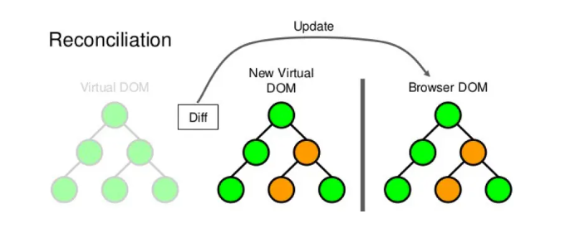
Virtual DOM
How the Virtual DOM Works?
For every update done on the Virtual DOM, a new virtual DOM tree is created, React compares the new Virtual DOM with a snapshot of the initial state before the update was done.
with the help of this comparison done by react js, it automatically figures out which part of your react component needs to be updated.
React uses what we call the diffing algorithm to do this and the process of using this diffing algorithm is called diffing.
once reacts compares, it then updates the components which need to be updated with the updated nodes.

Slide 20
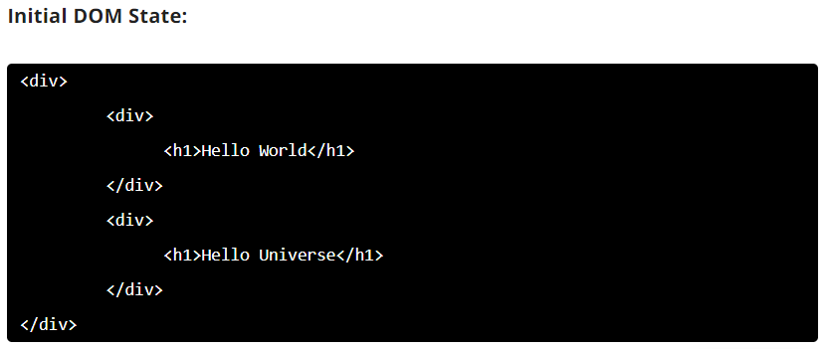
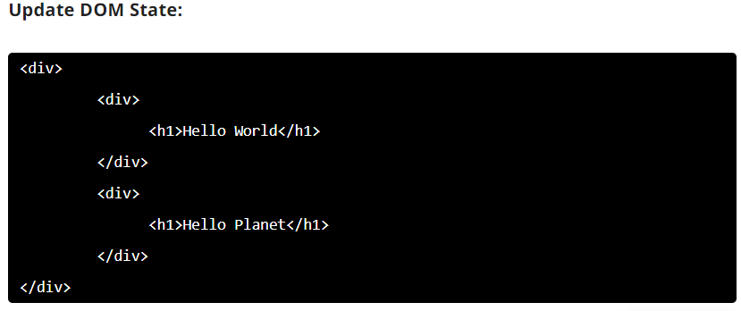
Virtual DOM

Slide 21
Virtual DOM
Initial Virtual DOM
Updated Virtual DOM
DIV
DIV
Change in DOM
DIV
DIV
DIV
DIV
h1
h1
h1
h1
Hello World
Hello Universe
Hello World
Hello Panel
Change in Value

Slide 22
Virtual DOM
Why Virtual DOM is faster?
Virtual DOM is a JavaScript Object.
Creation and looking for state changes is done Virtual DOM, so accessing the elements do not require rendering the elements of DOM.
When the final decision is made that required to be changed then only the real DOM is changed and only the changed element is re-rendered not all DOM elements

Slide 23
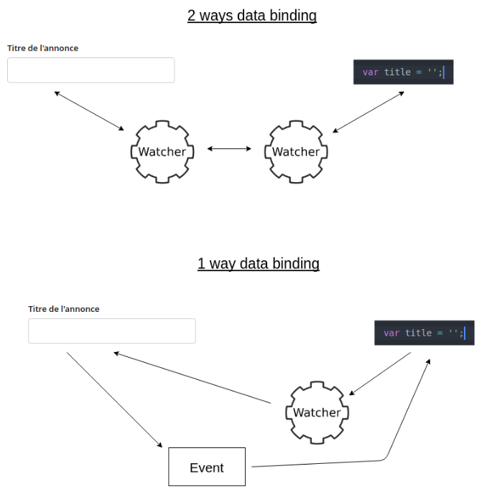
One-way Data Binding
Angular uses watcher which is bi-directional for 2-way data binding.
But, for react the watcher is one directional, if we need to use 2-way binding, then we have to use events to inform component about the change

Slide 24
JSX
JSX-JavaScript and XML
It is a syntax extension to JavaScript.
It allows us to write HTML elements in JavaScript and place them in the DOM without any createElement() and/or appendChild() methods.
JSX converts HTML tags into react elements.

Slide 25
Why JSX?
React embraces the fact that rendering logic is inherently coupled with other UI logic: how events are handled, how the state changes over time, and how the data is prepared for display.
Instead of artificially separating technologies by putting markup and logic in separate files, React separates concerns with loosely coupled units called “components” that contain both.
const element = <h1>Welcome to GeeksforGeeks.</h1>;

Slide 26
Characteristics of JSX
JSX is not mandatory to use there are other ways to achieve the same thing but using JSX makes it easier to develop react application.
JSX allows writing expression in { }. The expression can be any JS expression or React variable.
To insert a large block of HTML we have to write it in a parenthesis i.e, ().
JSX produces react elements.
JSX follows XML rule.
After compilation, JSX expressions become regular JavaScript function calls.
JSX uses camelcase notation for naming HTML attributes. For example, tabindex in HTML is used as tabIndex in JSX.

Slide 27
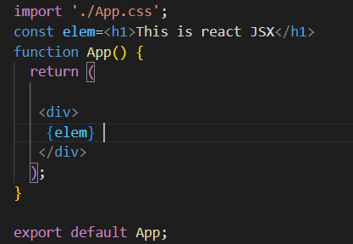
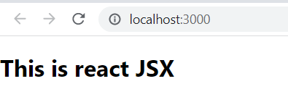
JSX
JSX

Slide 28
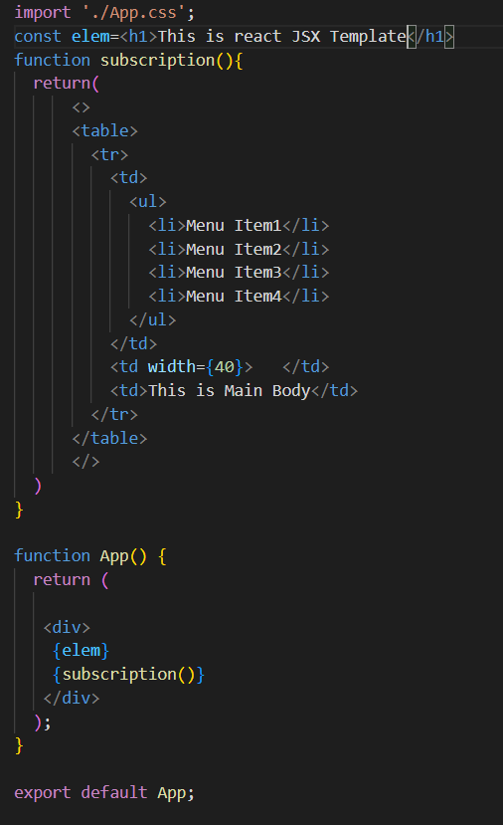
Template Design in JSX

Slide 29
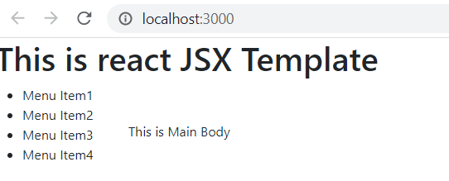
Template Design in JSX

Slide 30
Advantage of JSX
JSX makes it easier to write or add HTML in React.
JSX can easily convert HTML tags to react elements.
It is faster than regular JavaScript.
JSX allows us to put HTML elements in DOM without using appendChild() or createElement() method.
As JSX is an expression, we can use it inside of if statements and for loops, assign it to variables, accept it as arguments, or return it from functions.
JSX prevents XSS (cross-site-scripting) attacks popularly known as injection attacks.
It is type-safe, and most of the errors can be found at compilation time.

Slide 31
Disadvantage JSX
JSX throws an error if the HTML is not correct.
In JSX HTML code must be wrapped in one top-level element otherwise it will give an error.
If HTML elements are not properly closed JSX will give an error.

Slide 32
Component in React
A Component is one of the core building blocks of React.
A React component represents a small chunk of user interface in a webpage.
every application in React is made up of pieces called components.
It lets you divide the application responsibility into different individual entities.

Slide 33
Component in React
Components Responsibilities: The primary job of a React component is to render its user interface and update it whenever its internal state is changed. In addition to rendering the UI, it manages the events belongs to its user interface. In summary,
Initial rendering of the user interface.
Management and handling of events.
Updating the user interface whenever the internal state is changed.

Slide 34
Component in React
How Component Objectives is Achieved?
React component accomplish these feature using three concepts −
Properties − Enables the component to receive input.
Events − Enable the component to manage DOM events and end-user interaction.
State − Enable the component to stay stateful. Stateful component updates its UI with respect to its state.

Slide 35
Component in React
Types of Component
Functional
Class

Slide 36
Component in React
Functional Component:
It is simply javascript functions.
These functions may or may not receive data as parameters.
const Democomponent=()=> {
return <h1>Welcome Message!</h1>;
}

Slide 37
Component in React
2. Class Component:
It is a little more complex than the functional components.
The functional components are not aware of the other components in your program whereas the class components can work with each other.
We can pass data from one class component to other class components.
We can use JavaScript ES6 classes to create class-based components in React.
class Democomponent extends React.Component {
render(){
return <h1>Welcome Message!</h1>;
}
}

Slide 38
Component in React
Rendering Components:
The rendering of component is very simple. We can render in
App.js file
Index.js file
const elementName = <ComponentName />;

Slide 39
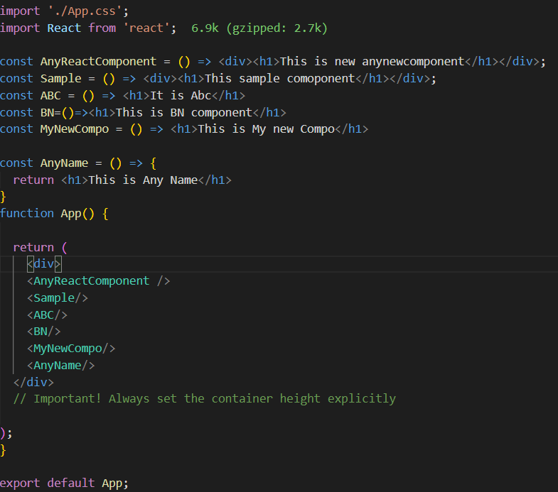
Component in React
Rendering Components in App.js:

Slide 40
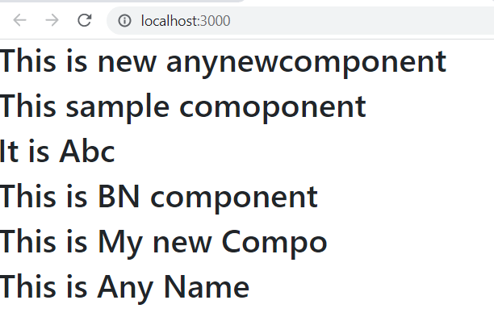
Component in React

Slide 41
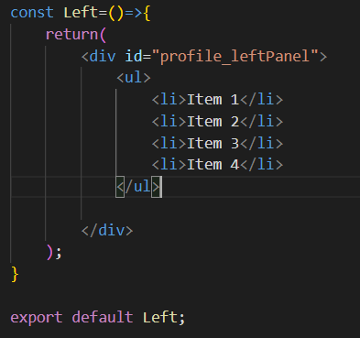
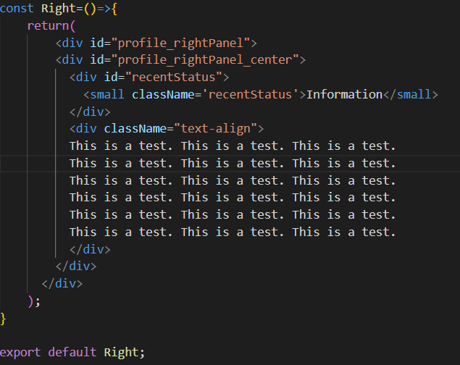
Component in React
Design Component in separate files:
leftPanel.js
rightPanel.js

Slide 42
Component in React
#profile_leftPanel {
width: 150px;
float: left;
border-right: 1px solid #666;
margin-right: 20px;
}
#profile_leftPanel li:nth-child(odd){
text-decoration: none;
border: 0cqi;
list-style-type:none;
background: #ffe5e5;
color: darkred;
}
#profile_leftPanel li:nth-child(even){
text-decoration: none;
border: 0cqi;
list-style-type:none;
background: #19d496;
color: darkred;
}
#profile_rightPanel_center {
margin-left: auto;
margin-right: auto;
text-align: center;
}
#recentStatus {
width: 400px;
text-align: center;
display: inline;
}
.text-align{
text-align: left;
}

Slide 43
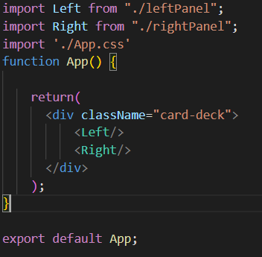
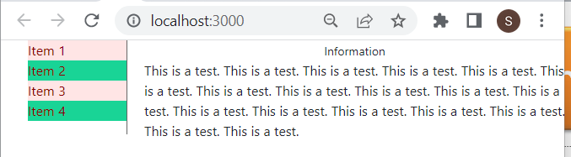
Component in React
Rendering in App.js

Slide 44
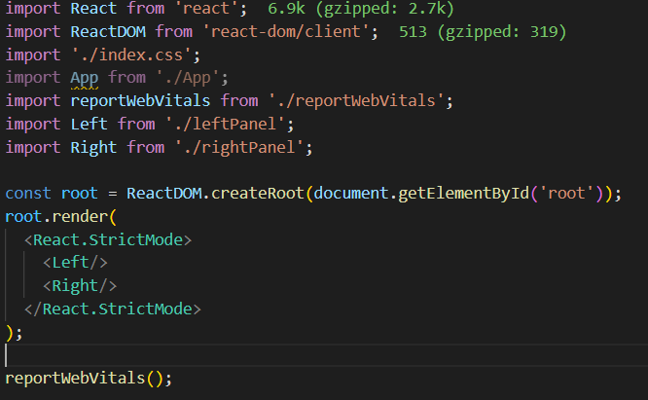
Component in React
Index.js

Slide 45
Naming Conventions in React
In React applications, there are 3 most common naming conventions:
Camel case for file names, and pascal case for component names
Kebab case for file names, and pascal case for component names
Pascal case for both file names, and component names

Slide 46
Component in React
Camel Case: Camel case is the practice of writing phrases without spaces or punctuation, indicating the separation of words with a single capitalized letter. Example:appContainer.
Kebab case: Kebab case is a programming variable naming convention where a developer replaces the spaces between words with a dash. Example: app-container.
Pascal case: Pascal case is following the same format as the camel case. In addition, it requires the first letter to be uppercase as well, while the camel case does not.Example: AppContainer.

Slide 47
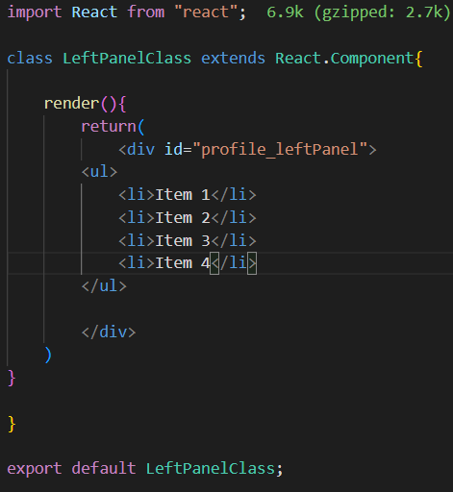
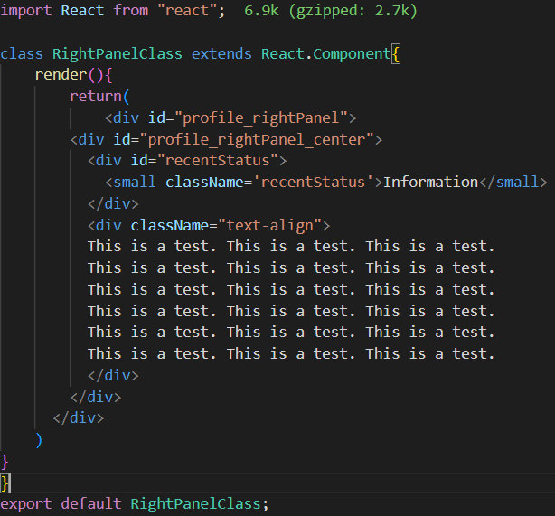
Component in React
Class Component:
LeftPanelClass.js
RightPanelClass.js

Slide 48
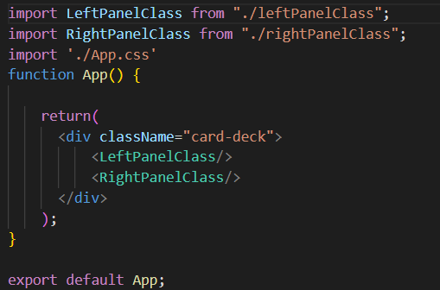
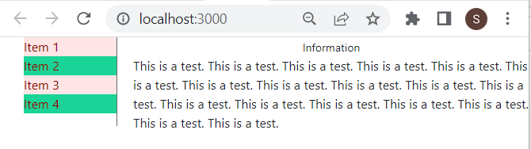
Component in React
App.js

Slide 49
State and Props in React
What is state?
The state is a built-in React object that is used to contain data or information about the component.
A component’s state can change over time; whenever it changes, the component re-renders.
The change in state can happen as a response to user action or system-generated events and these changes determine the behavior of the component and how it will render.

Slide 50
State and Props in React
What is Props?
Props are basically data that flows from one to another component as a parameters.
Props can not be modified in a component.
React’s data flow between components is uni-directional (from parent to child only).
React Props are like function arguments in JavaScript and attributes in HTML.
Component use this data to generate dynamic html elements.

Slide 51
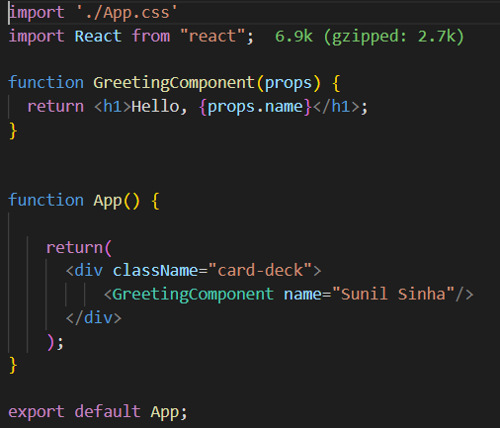
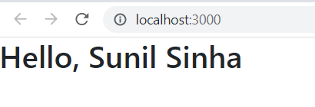
State and Props in React
App.js, Passing parameters using function component

Slide 52
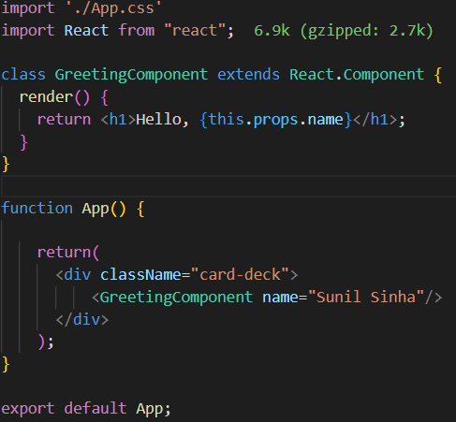
State and Props in React
App.js, Accessing props object using class component

Slide 53
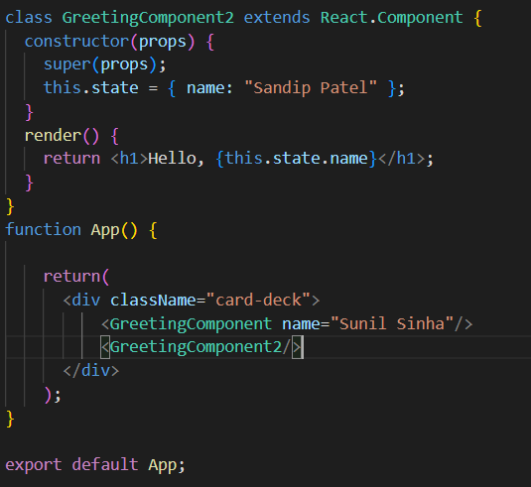
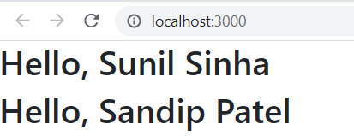
State and Props in React

Slide 54
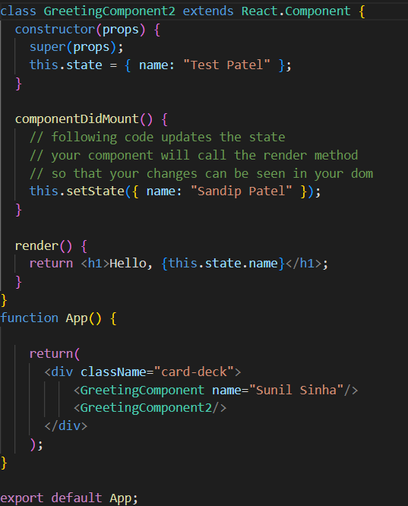
State and Props in React
The component state can be changed using setState method.
The change can be implemented using events like click, change etc.

Slide 55
State and Props in React
SN | Props | State
1. | Props are read-only. | State changes can be asynchronous.
2. | Props are immutable. | State is mutable.
3. | Props allow you to pass data from one component to other components as an argument. | State holds information about the components.
4. | Props can be accessed by the child component. | State cannot be accessed by child components.
5. | Props are used to communicate between components. | States can be used for rendering dynamic changes with the component.
6. | Stateless component can have Props. | Stateless components cannot have State.
7. | Props make components reusable. | State cannot make components reusable.
8. | Props are external and controlled by whatever renders the component. | The State is internal and controlled by the React Component itself.

Slide 56
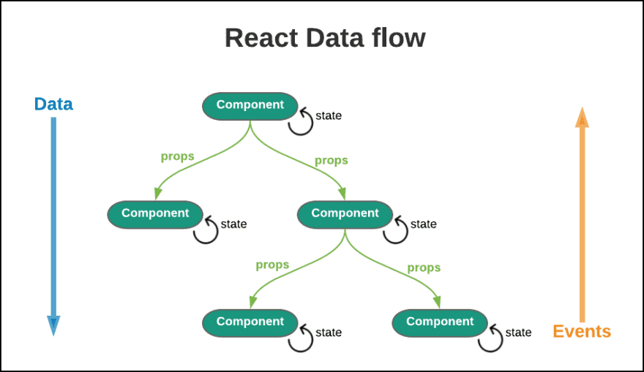
React Dataflow

Slide 57
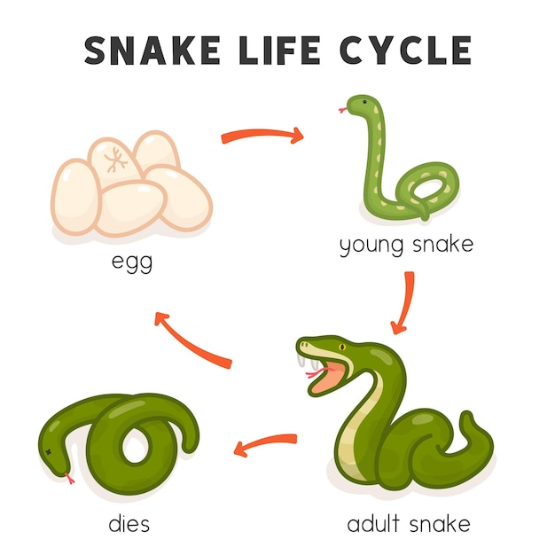
Lifecycle of a Component

Slide 58
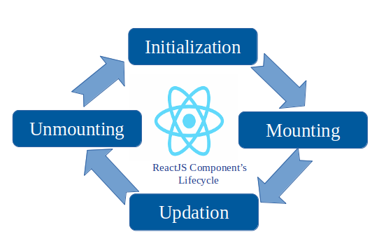
Lifecycle of a Component
Every React Component has a lifecycle of its own, lifecycle of a component can be defined as the series of methods that are invoked in different stages of the component’s existence.

Slide 59
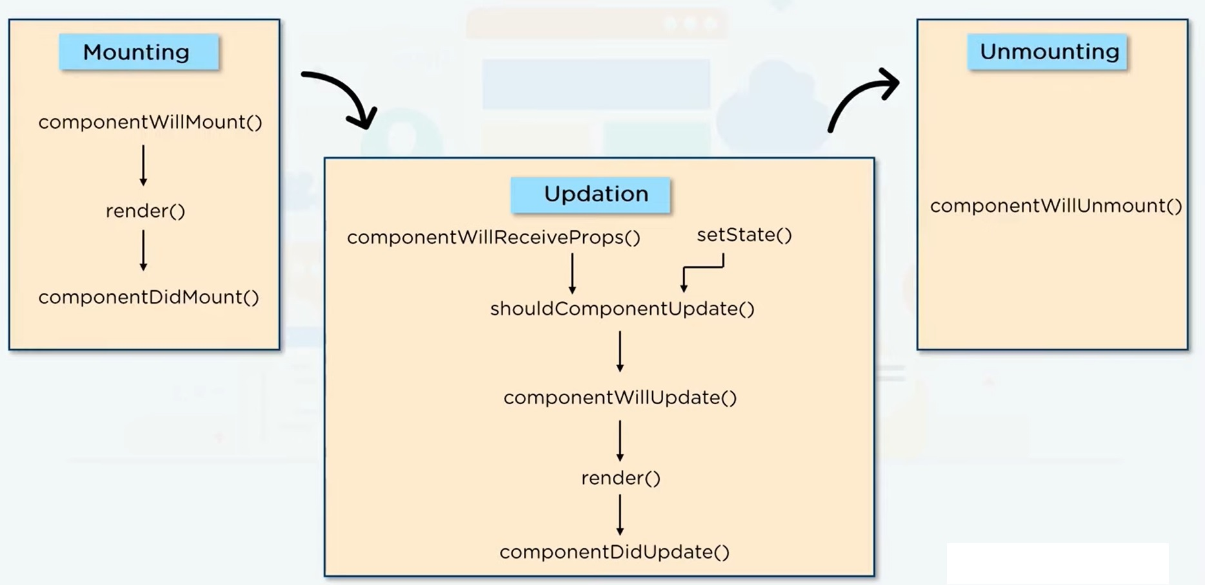
Lifecycle of a Component

Slide 60
Lifecycle of a Component
Initial Phase:
It is the birth phase of the lifecycle of a ReactJS component.
a component contains the default Props and initial State.
These default properties are done in the constructor of a component.
The initial phase only occurs once and consists of the following methods.
i) getDefaultProps() It is used to specify the default value of this.props. It is invoked before the creation of the component or any props from the parent is passed into it.
ii) getInitialState() It is used to specify the default value of this.state. It is invoked before the creation of the component.

Slide 61
Lifecycle of a Component
2. Mounting Phase:
Mounting is the phase of the component lifecycle when the initialization of the component is completed and the component is mounted on the DOM and rendered for the first time on the webpage.
React follows a default procedure in the Naming Conventions of these predefined functions where the functions containing “Will” represents before some specific phase and “Did” represents after the completion of that phase.

Slide 62
Lifecycle of a Component
The mounting phase consists of two such predefined functions as described below:
componentWillMount() Function: As the name clearly suggests, this function is invoked right before the component is mounted on the DOM i.e. this function gets invoked once before the render() function is executed for the first time.
componentDidMount() Function: Similarly as the previous one this function is invoked right after the component is mounted on the DOM i.e. this function gets invoked once after the render() function is executed for the first time

Slide 63
Lifecycle of a Component
3. Updation:
Updation is the phase where the states and props of a component are updated followed by some user events such as clicking, pressing a key on the keyboard, etc.
It’s important since realtime updation creates active pages, which ReactJS support to build application.

Slide 64
Lifecycle of a Component
i) componentWillReceiveProps() Function:
This is a Props exclusive Function and is independent of States.
This function is invoked before a mounted component gets its props reassigned.
The function is passed the new set of Props which may or may not be identical to the original Props.
Thus checking is a mandatory step in this regard.

Slide 65
Lifecycle of a Component
ii) setState() Function:
This is not particularly a Lifecycle function and can be invoked explicitly at any instant.
This function is used to update the state of a component.

Slide 66
Lifecycle of a Component
iii) shouldComponentUpdate() Function:
By default, every state or props update re-render the page but this may not always be the desired outcome, sometimes it is desired that updating the page will not be repainted.
It fulfills the requirement by letting React know whether the component’s output will be affected by the update or not.
It is invoked before rendering an already mounted component when new props or state are being received.
If returned false then the subsequent steps of rendering will not be carried out.
The Function takes the new Props and new State as the arguments and returns whether to re-render or not.

Slide 67
Lifecycle of a Component
iv) componentWillUpdate() Function:
this function is invoked before the component is rerendered i.e. this function gets invoked once before the render() function is executed after the updation of State or Props.

Slide 68
Lifecycle of a Component
v) componentDidUpdate() Function:
This function is invoked after the component is rerendered i.e. this function gets invoked once after the render() function is executed after the updation of State or Props.

Slide 69
Lifecycle of a Component
4. Unmounting:
This is the final phase of the lifecycle of the component that is the phase of unmounting the component from the DOM.
componentWillUnmount() Function: This function is invoked before the component is finally unmounted from the DOM i.e. this function gets invoked once before the component is removed from the page and this denotes the end of the lifecycle.

Slide 70
Lifecycle of a Component
import React from 'react'; export default class RactCompoLifeCycle extends React.Component {
constructor(props)
{
super(props);
this.state = { hello : "World!" };
}
componentWillMount()
{
console.log("componentWillMount()");
}
componentDidMount()
{
console.log("componentDidMount()");
}
changeState()
{
this.setState({ hello : "Geek!" });
}
render()
{
return (
<div>
<h1>Hello Planet, Hello{ this.state.hello }</h1>
<h2>
<a onClick={this.changeState.bind(this)} href="/#">Press Here!</a>
</h2>
</div>);
}
shouldComponentUpdate(nextProps, nextState)
{
console.log("shouldComponentUpdate()");
return true;
}
componentWillUpdate()
{
console.log("componentWillUpdate()");
}
componentDidUpdate()
{
console.log("componentDidUpdate()");
}
}

Slide 71
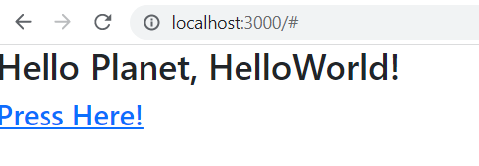
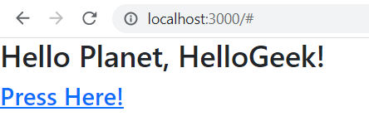
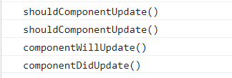
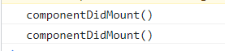
Lifecycle of a Component
After Page Loading
After the click event

Slide 72
Rendering List in React
List is very basic feature of JavaScript.
It is usually collection objects: number, character, string or any user defined objects
Example: var number=[1,2,4,5,6].
Now question is, how can we render list in React?

Slide 73
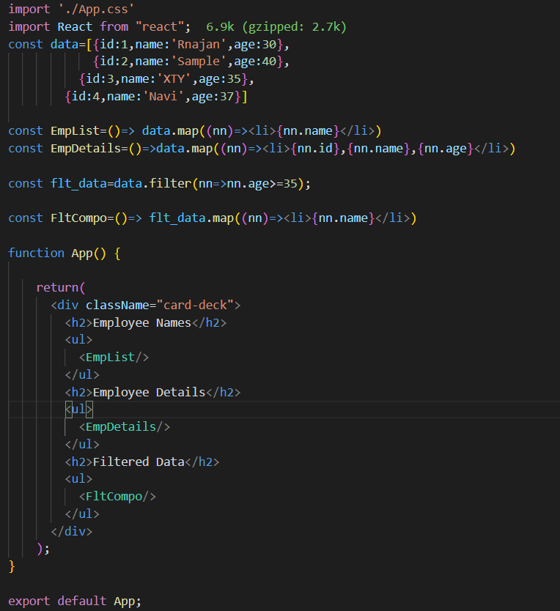
Rendering List in React

Slide 74
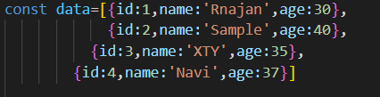
Rendering List in React
1. We have created a list of JSON objects
2. We have created a functional component to show name of the employees only. The map function here creates an iterator “nn” which iterates through the array provides the name of the employees only

Slide 75
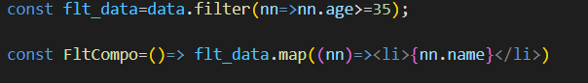
Rendering List in React
3. Create another functional component to show employee details
4. We can also filter list and show data from the filtered data

Slide 76
Rendering List in React
An Alternative Approach to render list in Component
let list2=[]
for(let i=0;i<data2.length;i++){
list2.push(<li>{data2[i].id},{data2[i].name},{data2[i].age}</li>)
}
const data=[1,2,3,4];
const data2=[{id:1,name:'abc',age:40},
{id:2,name:'hty',age:30},
{id:3,name:'szy',age:35},
{id:4,name:'yut',age:38}];
return(
<>
<h1>Home Works</h1>
<ul>
{li}
</ul>
<h2>Employee Details</h2>
<ul>
{list2}
</ul>
</>
)
let li=[];
for(let i=0;i<4;i++){
li.push(<li> Item {data[i]}</li>)
}

Slide 77
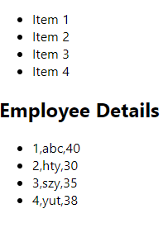
Rendering List in React
An Alternative Approach to render list in Component

Slide 78
Hooks in React
It is an advance feature using which we can use class all the react feature without writing a class.
For example, state of react component.
It has been introduced in react version 16.8.
Hooks work only inside the function not in class.
It helps to get class like features inside function.

Slide 79
Why Hooks
The problem with using “this” keyword in JavaScript.
Difficulty to bind event handler to class component.
Classes cannot minify very well
Classes make difficult hot reloading.
Reusing is not possible for statefull component logic

Slide 80
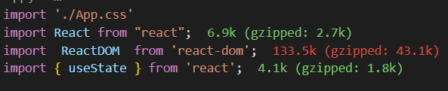
Example of Hook
1. Import the module “useState”

Slide 81
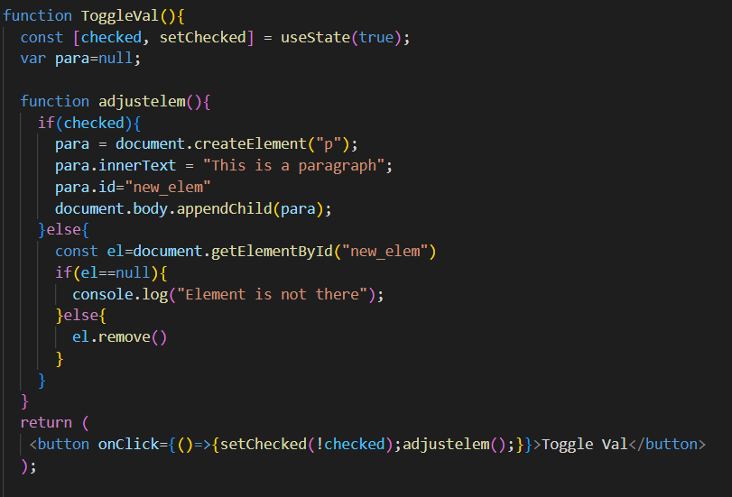
Example of Hook
2. Create the component to use Hook useState

Slide 82
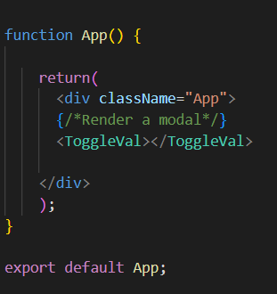
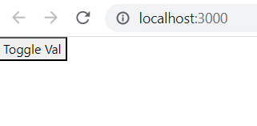
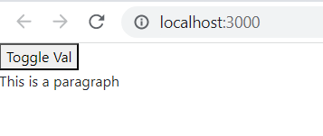
Example of Hook
On page load
This is after clicking on Button

Slide 83
Rendering Portals in React
What is React Portals?
React Portals are an advanced concept that allows developers to render their elements outside the React hierarchy tree without comprising the parent-child relationship between components.
A typical React components are located within the DOM.
This means that it might be tricky for you to render modals or pop-up windows.

Slide 84
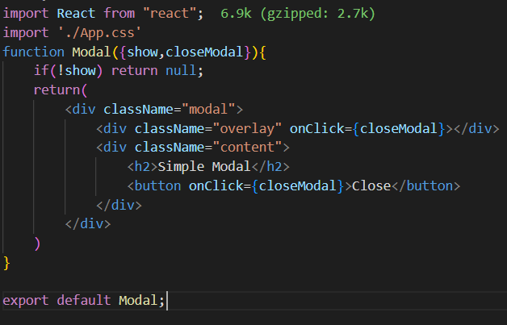
Rendering Portals in React
Modal.js

Slide 85
Rendering Portals in React
App.css
.modal {
display: flex;
align-items: center;
justify-content: center;
height: inherit;
width: 100%;
position: absolute;
top: 0;
bottom: 0;
left: 0;
right: 0;
}
.overlay {
width: 100%;
height: 100%;
background-color: rgba(0, 0, 0, 0.5);
position: absolute;
top: 0;
bottom: 0;
left: 0;
right: 0;
z-index: 1;
backdrop-filter: blur(2px);
}
.content {
background-color: white;
z-index: 2;
padding: 32px;
box-shadow: 0 1px 12px rgba(0, 0, 0, 0.5);
display: flex;
flex-direction: column;
border-radius: 8px;
}
.content > button {
margin: 12px;
}

Slide 86


Rendering Portals in React

Slide 87


Rendering Portals in React

Slide 88
What is Error Handling
When particular resource we are seeking is not available or any other odd circumstances react provides a broken page.
Nobody wants to see a broken, empty page while surfing the web. It leaves you stranded and confused.
To provide a specific output when an error occurs and maintain application state aw well

Slide 89

Error Handling(try….catch)
The traditional JavaScript has a smart error handling feature i.e. try..catch block.
In react, we can also use such block using useEffect hook.
Here, we are trying to catch error when we cannot get any user information, and in such scenario we are going to setError method the hook

Slide 90
Error Handling(try….catch)
But try..catch good for imperative codes.
In react, we use JSX which is declarative codes.
Declarative code is what we say that it tells about what to do, not how to do.

Slide 91
Error Boundary
React implements error handling using Error Boundary.
Error boundaries are React components that catch JavaScript errors anywhere in their child component tree.
they log those caught errors and display a fallback UI instead of the component tree that crashed.
Error boundaries catch errors during rendering, in lifecycle methods, and in constructors of the whole tree below them.
An error boundary is a class component that defines either (or both) of the lifecycle methods static getDerivedStateFromError() or componentDidCatch(). static getDerivedStateFromError() renders a fallback UI after an error has been thrown.
componentDidCatch() can log error information

Slide 92

Error Boundary
Here in the we are going to use props which does exits.
It will lead to broken page.

Slide 93

Error Boundary

Slide 94

Error Boundary
Error Boundary Component

Slide 95

Error Boundary

Slide 96

Error Boundary

Slide 97

Error Boundary

Slide 98
Routers
What is React Routers?
It is a fully- features client and server side routing library for react
Helps to create and navigate between different URLs that make up your web application.
Provides unique URLs for the different components in the app and makes the UI easily shareable with other users.

Slide 99
Routers
Course of Action:
Configuring routes
Navigating on Button Click
Navigating Programmatically
Dynamic routes
Nested route
Route Parameters
Lazy loading
Authentication

Slide 100


Routers
Installation and Setup:
1. Install the third-party library react-router-dom
2. Create Component Folder and create twofiles: Home.js, About.js in the folder

Slide 101


Routers
3. Create The content for Home Component
4. Create the content of About Component

Slide 102

Routers
Import BrowserRouter
Include App component inside the Browserrouter tag

Slide 103

Routers
Import Routes, Route to add routing pages in the app. And we have to import component also
Routes and Route tag are used to add target component while routing

Slide 104


Routers
We have write about to get about page

Slide 105

Routers
Routers creating using menu
1. Create a navigation bar (Navbar.js)
A new term we are using “Link”, which is an element that lets the user navigate to another page by clicking or tapping on it.
react-router-dom, a <Link> renders an accessible <a> element with a real href that points to the resource it's linking to.

Slide 106
Routers
Routers creating using menu
2. Create Three components
Home.js
Product.js
Sales.js

Slide 107

Routers
Routers creating using menu
3. Modify the App.js file
Import all components
Place Navbar component before Routes tag

Slide 108
Routers
Routers creating using menu
4. Add following CSS style to App.css
.flex-container {
display: flex;
background-color: DodgerBlue;
justify-content: left;
}
.flex-container > div {
background-color: #db9898;
margin: 10px;
padding: 20px;
font-size: 30px;
}
.flex-container > a {
background-color: #db9898;
margin: 10px;
padding: 20px;
font-size: 30px;
text-decoration: none;
} .flex-container > #right {
background-color: #db9898;
margin-left: 70%;
padding: 10px;
font-size: 30px;
}

Slide 109

Routers
Routers creating using menu
Output for Home Menu

Slide 110

Routers
Routers creating using menu
Output for Product Menu

Slide 111

Routers
Routers creating using menu
Output for Sales Menu

Slide 112

Routers
Routing through code
Change the content of Home.js as:
Import useNavigate Module
Create a reference to that module
Use ‘order-summary’ path in navigation. One Component for that has already been created and path information is provided into App.js

Slide 113


Routers
Routers creating using menu
Initially Home page will come. After clicking on button the order-summary page will come

Slide 114
Nested Routers
a way of organizing and structuring routes in a web application.
It involves defining child routes within a parent route, so that a particular URL endpoint can have multiple sub-endpoints with their own unique paths.
For example, A product route can provide two different routes: Product details and product feedback.

Slide 115

Nested Routers
How we can do nested routes in react?
1. Modify Product.js file as follows
Import Outlet Module
Create another navigation bar inside Product component with Link details
Create an Outlet element after navigation bar

Slide 116
Nested Routers
Add a CSS Style to App.css file
.sub-container > a {
background-color: #db9898;
margin: 10px;
padding: 20px;
font-size: 30px;
text-decoration: none;
}

Slide 117

Nested Routers
Import the newly created Components
Add the routing Information under Product routing. This creates relative routing path

Slide 118

Nested Routers
Follow the URL and what information is coming in webpage

Slide 119

Nested Routers
Loot at the URL, how it is changing after clicking on Product details tab

Slide 120

Nested Routers
This is for Product Feedback Output

Slide 121
Dynamic Routers
Dynamic routing is the time at which the routing takes place.
In dynamic routing, routes are initialized dynamically when the page gets rendered.
But, in static routing we have to configure each of the routing before we use it.

Slide 122


Dynamic Routers
Create Two Components
Users.js
UserDetails.js

Slide 123

Dynamic Routers
NavBar.js
Add Users Option in Navigations bar

Slide 124

Dynamic Routers
Add Users and UserDetails Modules to App.js
Add router path to App.js

Slide 125

Dynamic Routers

Slide 126

Dynamic Routers
Adding 1 after users changes the output

Slide 127

Dynamic Routers
App.js
Look at the configuration we have changed. Using this configuration we don’t need to create static mapping for each userId. Dynamically the number will be taken. This is an example of dynamic mapping

Slide 128

Dynamic Routers
Dynamic routing we can also read URL parameters
Import useParams modules
Get reference to the parameters and fetch the parameter value
Use JSX expression to print the data

Slide 129
Active Navigation
In case of navigation we sometimes need to show which link is active.
The active link should be displayed different way than the other navigation options.
It can be implemented using “navlink” component of react.
It create a class called “active” and dynamically add it to the link.

Slide 130

Active Navigation

Slide 131
Authentication

Slide 132
Active Navigation
Add the following CSS style to your App.css file
a.active{
background-color:#cc0000;
border:1px solid #660000;
border-radius:5px;
color:#fff;
margin-right:10px;
padding:10px 10px 10px 10px;
text-decoration:none;
font-size: 24px;
font-weight: bold;
}
a{
background-color:#3338d6;
border:1px solid #660000;
border-radius:5px;
color:#fff;
margin-right:10px;
padding:10px 10px 10px 10px;
text-decoration:none;
font-size: 24px;
font-weight: bold;
}

Slide 133
useContext Hook

Slide 134
Problem With Unidirectional Data Flow
React support only parent to child data communication.
If any parent wants data it needs to send data through all the child component to the target child component.
This makes thing worse.
The child component which does not require the information, it still needs to process it since it comes in the middle communication.

Slide 135
Problem With Unidirectional Data Flow
Parent
Note: information is transferred using “props”
First Child
The data passes through each component
Second Child
Third Child
Third child requires data

Slide 136

Problem With Unidirectional Data Flow
Using props name from C1 to C2 I am passing information

Slide 137

Problem With Unidirectional Data Flow

Slide 138
useContext Hook
This hook provides a mechanism to access the parent data from any child component without passing the same data through all the component along the path.
Any child who wants access the data can create a context hook to make a link and access the required data.

Slide 139
useContext Hook
useContext is an component object.
It is also a Hook.
It is at the top level of the hierarchy of components i.e. It is all the components who wants to use application state must be a children of useContext object.

Slide 140

useContext Hook
Application useContext.
1. Create a useContext component. Create a file userContext.js and write the following lines of codes

Slide 141


useContext Hook
Create Two components Home and About
Home.js
About.js

Slide 142

useContext Hook
Create a navigation bar
Navbar.js

Slide 143

useContext Hook
App.js
Import context module
userContext acting as parent component and content of the value variable is accessed by all of its child compoents

Slide 144


useContext Hook

Slide 145
Welcome to Redux

Slide 146
What is State?
The particular condition that something is in at a specific time- according to Dictionary.com
the mental, emotional or physical condition that a person or thing is in- https://www.oxfordlearnersdictionaries.com/
For example, int a=0, the variable “a” is in initial state 0, if we set a=1, then “a” state is 1…
For, react application component is not that simple as variable “a”. It’s state more complex i.e. consists of many values of different type.

Slide 147
Types of Web App State
Application State: Application state is information about where you are in the interaction. It is used during your session with an application. For example, the fact that you can view any picture in google, or the fact that you are logged in on Twitter, are both application state. Changes to this state are possible by the controls in hypermedia representations. In the pictures case, they are links, and on Twitter, they are the tweet box and button.

Slide 148
Types of Web App State
Resource State: It refers to the state of the resources being stored on the server. These can be files, images, database records, etc. Resource state changes as resources are added, modified, or deleted.

Slide 149
Types of Web App State
Session State: keeps track of user interaction during a browser session. It holds the status of the communication between the client and the server and now we use it broadly to describe that state that relates to a session ID and http cookies. It is session state that remembers the page you were last on, like holding your cart items so they are still there if you close your browser and navigate back to where you were shopping before, and informs the website as to whether or not you are authorized to view a specific page.

Slide 150
Redux
What is Redux?
Why Redux?
Components of Redux
Principles
Redux Life cycle

Slide 151
What is Redux?
Redux is a predictable state container for JavaScript apps.
Redux is a pattern and library for managing and updating application state, using events called "actions". [https://redux.js.org/tutorials/essentials/part-1-overview-concepts].
It serves as a centralized store for state that needs to be used across your entire application, with rules ensuring that the state can only be updated in a predictable fashion.

Slide 152
Why Redux?
Redux helps you manage "global" state - state that is needed across many parts of your application.
The patterns and tools provided by Redux make it easier to understand when, where, why, and how the state in your application is being updated, and how your application logic will behave when those changes occur.
Redux guides you towards writing code that is predictable and testable, which helps give you confidence that your application will work as expected.

Slide 153
When Redux is useful?
You have large amounts of application state that are needed in many places in the app
The app state is updated frequently over time
The logic to update that state may be complex
The app has a medium or large-sized codebase, and might be worked on by many people

Slide 154
Component of Redux
Store: the global app state
Actions: objects that describe “what happened”
Reducers: functions that return the next state based on an action
Dispatching: triggering a state update by sending an action

Slide 155

Redux Life Cycle
The information flow is one-directional

Slide 156
Three Principles of Redux
Your app state (Redux store) is the single source of truth.
Like in React, the state is read-only. Never mutate your state directly.
State changes are made with pure functions (no side effects).[E.g. Don’t make an API call inside of a reducer.]

Slide 157

Redux in Action

Slide 158
Initial setup in React for Redux
To work with Redux in React we need to install two packages: redux and react-redux.
npm install redux
npm install react-redux

Slide 159
Simple Implementation Redux
What Actions need to be taken?
Create Action object.
Create a initial state
Import redux package
Create redux store
Provide this store to app component

Slide 160
Simple Implementation Redux
Responsibilities of Redux Store:
Holds application state
Allows access to state via getState function
Allows state to be updated using dispatch(action)
Register listener via subscribe(listener)

Slide 161
Redux Example
Initial setup for example:[create folder with any name and go to that folder using command prompt and follow the given steps]
Type at command prompt: npm init
Install required packages: npm install redux
Create a file : index.js

Slide 162

Redux Example
Create action object buyBook. Whenever this function is
called the object is returned

Slide 163

Redux Example
Crete the initial state
Create the reducer with state as initial state and action object
Modification of global state and new state is returned

Slide 164

Redux Example
Import redux module
Create store with redux
Registering listener
Updating state with dispatch method of srore

Slide 165

Redux Example

Slide 166
Multiple State in Redux
In web application, we often use components to build application.
Any component is very complex entity.
To represent state of such complex entity we may need different state information of different type.
For our buy book example, we may need to maintain different type of books like-horror or adventure books. Therefore, we need to maintain different state for different books.

Slide 167

Redux Example
We are declaring different types of books and action object also

Slide 168

Multiple State in Redux
We need to main two information for the state as initial state information

Slide 169

Multiple State in Redux
We need to modify our reducer adding another option for adventure book

Slide 170

Multiple State in Redux
We need to add dispatcher function to apply different modification to different information in the store
The subscribe function returns a function to unregister the listener. So we storing the function into a variable unsubscribe and calls it when it is necessary

Slide 171
Multiple State in Redux
The complexity of state management increases as we increase number of information in state.
If we keep everything in one reducer, then it becomes very complex to all information manage.
The solution is, we can have different reducers for different information in state.
For example, we can create a reducer for buying horror book and another reducer for adventure book.
But problem is, we can have only one store.
Then what is the solution: Reducer group[combineReducer].

Slide 172
Reducer Group in Redux
As your app grows more complex, you'll want to split your reducing function into separate functions, each managing independent parts of the state.
We do it using “combineReducer” method of redux in store.

Slide 173

combineReducer Redux Example
We are going to create two reducers for actions: BUY_HORROR_BOOK, BUY_ADVENTURE_BOOK
Import the module
Two action patterns

Slide 174

combineReducer Redux Example
Returning different action objects

Slide 175

combineReducer Redux Example
Setting up initial state value

Slide 176

combineReducer Redux Example
Reducer for BUY_HORROR_BOOK Action

Slide 177

combineReducer Redux Example
Create reducers for BUY_ADVENTURE_BOOK Action

Slide 178

combineReducer Redux Example
Combining different reducers
Registering reducers
Apply different actions to dispatch

Slide 179

combineReducer Redux Example

Slide 180
React-Redux
So far, we have seen application of redux.
The redux can be implemented in react also.
We need add one package : react-redux.

Slide 181
React-Redux Example
The outline of the example is as:
Create three actions: INC,DEC,ADD
Create a reducer that will address all these three actions and update the store accordingly
Update index.js file to apply the store to the whole application.
Finally, in App.js file add three button to initiate all three actions using useSelector and useDispatch Hook

Slide 182

React-Redux Example
Changing the states using different actions

Slide 183

React-Redux Example
We have to import two important hooks: useSelector and useDispatch ini App.js file

Slide 184

React-Redux Example
Create a reference to the state
Create a reference to dispatch function
Dispatching the action to the reducers

Slide 185

React-Redux Example
Initiate events to generate actions

Slide 186

React-Redux Example
Import provider and store
Wrap the provider around your app and provide the store to the provider

Slide 187

React-Redux Example

Slide 188
Welcome to Redux-Saga

Slide 189
What is Redux-Saga?
It is a library that aims to make application side effects
The mental model is that a saga is like a separate thread in your application that's solely responsible for side effects.
It is a redux middleware, which means this thread can be started, paused and cancelled from the main application with normal redux actions,
it has access to the full redux application state and it can dispatch redux actions as well.
It introduces asynchronous I/O in redux applications.
It uses an ES6 feature called Generators to make those asynchronous flows easy to read, write and test.

Slide 190
Why Redux-Saga?
Redux is synchronous. Sometimes redux can access the data which may not be available instantly.
It allows the Redux store to communicate asynchronously with resources outside of the store—this includes accessing the local storage, HTTP requests and executing input and output services that are managed efficiently.
It enhancers to override the dispatch function for Redux, but sometimes we are interested in customizing the dispatch function.

Slide 191

Architecture of Redux-Saga

Slide 192
Generator Function
Generator functions in Javascript are special functions that can generate a sequence of values.
JavaScript generators are just ways to make iterators.
They use the yield keyword to yield execution control back to the calling function and can then resume execution once the next() function is called again.
Once the generator runs out of values to return, it returns a value of undefined, and a done value of true, letting you know that there are no more values.

Slide 193

Generator Function
Syntax to create a generator function
Yield returns a value and pause the execution until the next request comes
Get a reference object for generator function
Fetch value one by one with next function

Slide 194
Initial Setup Redux-Saga
Install the redux-saga library
npm install redux-saga

Slide 195
Redux-Saga Api(s)
There are so many api(s) available to implement reduc-saga, but I have selected the important api(s) only:
Call
Put
Take
takeEvery
takeLatest
Select
createSagaMidleware
run

Slide 196
Redux-Saga Architecture
The whole responsibility of redux-saga is divided into two major functions
Worker module: it’s generating function that performs some api calls with dise effects
Watcher module: It is the root saga module which monitor different actions and calls the worker module when particular pattern for action is received.

Slide 197
Redux-Saga Example
List Actions For Example Buy book
Create an action buy book
Create a store to save the inventory
Create two components: one component generate the action to buy book, other will receive updated data
Create a saga middleware to dispatch an action to send data to the second component

Slide 198

Redux-Saga Example
1. Create a action object

Slide 199

Redux-Saga Example
2. Create a store, in which we have import certain files and initializer

Slide 200

Redux-Saga Example
It is dispatched by view
It is dispatched by Saga

Slide 201

Redux-Saga Example
Create a saga middleware object
Create the store and apply middleware at the same time
Finally run the root saga function

Slide 202

Redux-Saga Example
Important provider and store and wrap all App component with it

Slide 203

Redux-Saga Example
Worker module
Watcher module

Slide 204

Redux-Saga Example
Import Hooks and actions to implement in our app
Create a component that will initiate

Slide 205

Redux-Saga Example
The second component just show the state of the sore
Finally we embed the components inside the app

Slide 206


Redux-Saga Example

Slide 207
Welcome to Immutable.js

Slide 208
Immutable.js
What is immutable:
Immutable may describe something that is incapable of change.
Why immutability is important?
Immunity is a special feature that enhance the power of JavaScript in different occasions. the question is why immutability is important? It is important because if we change anything to the existing data and we replace the old date of the new data so the old data is lost. We cannot recover the old data if any case we feel that we have done some mistakes. So immutability does not allow us to change the existing data instead it forces us to create new object to the modified data so the advantages that if we want to go back to our old data we can easily to that.

Slide 209
Immutable.js
Immutability Vs mutability
mutable means capable of changing
Immutable means cannot change
stings are immutable in most programming languages
Objects are mutable in JavaScript

Slide 210
Immutable.js
JavaScript numbers are immutable
Let a=1
Let b=2
Let c=a + b
Strings are immutable
Let a="foo"
Let b="bar"
Let c=a + b

Slide 211
Immutable.js
Immutability in function:
The majority of JavaScript function are mutable for example the array has different functions like copywithin, fill, pop, push, reverse, shift, sort, pslice, unshift. These are all mutable function.
The immutable.js provides all important function in immutable way

Slide 212
Immutable.js
Immutable.js supports following immutable objects:
Map
List
Set
OrderedSet
Stack
Seq
Collection
Some common methods used
Get
Set
Update
remove

Slide 213

Immutable.js
Immutable JS Documentation:
https://immutable-js.com/docs/v4.3.0

Slide 214
Immutable.js
const { Map }=require("immutable");
const map1 = Map({ a: 1, b: 2, c: 3 });
const map2 = map1.set('b', 50);
console.log(map1.get('b') + ' vs. ' + map2.get('b')); // 2 vs. 50
Output:
2 vs. 50

